Slide 1
Music Store Analysis
Sql project
By aishwarya kadam

Slide 2
Objective :
Analyse the music playlist database
Understand its business growth by answering simple questions
Github Link: rishabhnmishra/SQL_Music_Store_Analysis: Data Analysis for Digital Music Store using SQL (github.com)
YouTube : https://youtu.be/VFIuIjswMKM

Slide 3
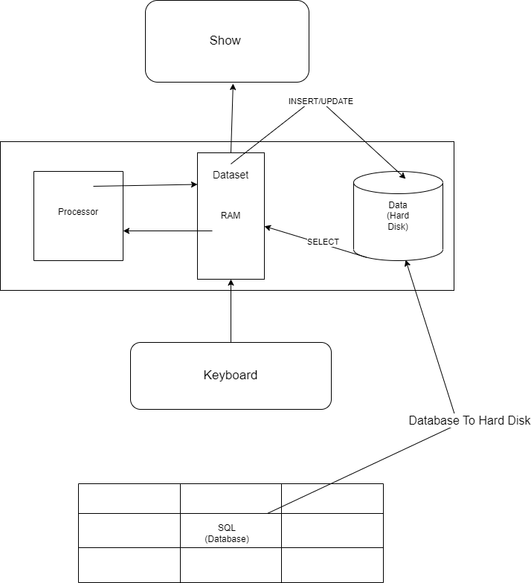

Slide 4
Tables :
Album
Artist
Customer
Employee
Genre
Invoice
Invoice_line
Media_type
Playlist
Playlist_track
Track
Steps :
Import data
(Import data from SQL database to pgAdmin i.e. Postgres)
Answer the Questions

Slide 5
/* Q1: Who is the senior most employee based on job title? */
SELECT title, last_name, first_name
FROM employee
ORDER BY levels DESC
LIMIT 1
/* Q2: Which countries have the most Invoices? */
SELECT COUNT(*) AS c, billing_country
FROM invoice
GROUP BY billing_country
ORDER BY c DESC
/* Q3: What are top 3 values of total invoice? */
SELECT total
FROM invoice
ORDER BY total DESC

Slide 6
/* Q4: Write query to return the email, first name, last name, & Genre of all Rock Music listeners.
Return your list ordered alphabetically by email starting with A. */
SELECT DISTINCT email,first_name, last_name
FROM customer
JOIN invoice ON customer.customer_id = invoice.customer_id
JOIN invoice_line ON invoice.invoice_id = invoice_line.invoice_id
WHERE track_id IN(
SELECT track_id FROM track
JOIN genre ON track.genre_id = genre.genre_id
WHERE genre.name LIKE 'Rock'
)
ORDER BY email;

Slide 7
/* Q5: Find how much amount spent by each customer on artists? Write a query to return customer name, artist name and total spent */
WITH best_selling_artist AS (
SELECT artist.artist_id AS artist_id, artist.name AS artist_name, SUM(invoice_line.unit_price*invoice_line.quantity) AS total_sales
FROM invoice_line
JOIN track ON track.track_id = invoice_line.track_id
JOIN album ON album.album_id = track.album_id
JOIN artist ON artist.artist_id = album.artist_id
GROUP BY 1
ORDER BY 3 DESC
LIMIT 1)
SELECT c.customer_id, c.first_name, c.last_name, bsa.artist_name, SUM(il.unit_price*il.quantity) AS amount_spent
FROM invoice i
JOIN customer c ON c.customer_id = i.customer_id
JOIN invoice_line il ON il.invoice_id = i.invoice_id
JOIN track t ON t.track_id = il.track_id
JOIN album alb ON alb.album_id = t.album_id
JOIN best_selling_artist bsa ON bsa.artist_id = alb.artist_id
GROUP BY 1,2,3,4
ORDER BY 5 DESC;

